Slide 1

Presentation Topic Energy, Water, Environment Sustainability
Department of Engineering & Applied Science
Roll No. | PRN | Name of student | Div. | VIIT email ID
1405 | 22110075 | Yash Gavit | N | yash.22110075@viit.ac.in
1412 | 22110206 | Prasad Nathe | N | prasad.22110206@viit.ac.in
1418 | 22110305 | Sahil Savardekar | N | sahil.22110350@viit.ac.in
1421 | 22110398 | Siddhesh Khairnar | N | siddhesh.22110398@viit.ac.in
BRACT’S, Vishwakarma Institute of Information Technology, Pune-48
(An Autonomous Institute affiliated to Savitribai Phule Pune University)
(NBA and NAAC accredited, ISO 9001:2015 certified)

Slide 2
Introduction of Energy Resources
What is Energy?:
There are different forms of energy on this planet. The Sun is considered as the elemental form of energy on the Earth. In Physics, energy is considered a quantitative property which can be transferred from an object in order for it to perform work. Hence, we can define energy as the strength to do any kind of physical activity.
Classification of Energy Source:
Energy sources can be divided into two types based on how quickly can they be replenished:
Non-conventional sources of Energy
Conventional sources of Energy
Student’s Name, Department of Engineering and Applied Sciences, VIIT, Pune-48

Slide 3
Non-conventional sources of Energy
Renewable energy sources, often known as non-conventional energy, are sources that are renewed by natural processes on a continual basis. Solar energy, wind energy, bio-energy (bio-fuels cultivated sustainably), hydropower, and other sustainable energy sources are some examples.
A renewable energy system transforms energy from the sun, wind, falling water, sea waves, geothermal heat, or biomass into heat or electricity that humans can utilize. The majority of renewable energy originates from the sun and wind, either directly or indirectly, and can never be depleted, which is why it is termed renewable.
However, traditional energy sources such as coal, oil, and natural gas provide the majority of the world’s energy. Non-renewable energy sources are the word used to describe these fuels. Despite the fact that the accessible amount of these fuels is enormous, they are finite and will, in theory, ‘run out’ at some point in the future.
Student’s Name, Department of Engineering and Applied Sciences, VIIT, Pune-48

Slide 4
Why is it necessary to use non-conventional energy sources?
With rising energy use, the population is becoming increasingly reliant on fossil fuels such as coal, oil, and gas. Because the prices of gas and oil continue to rise with each passing day, it is necessary to guarantee future energy supplies. As a result, we must employ more and more renewable energy sources. The government of India has established a distinct department called the “Department of non-conventional sources of energy” for the effective exploitation of non-conventional sources.
Student’s Name, Department of Engineering and Applied Sciences, VIIT, Pune-48

Slide 5
Types of Non-Conventional sources of energy
The most popular renewable energy sources currently are:
Solar energy.
Wind energy.
Hydro energy.
Tidal energy.
Geothermal energy.
Biomass energy.
Student’s Name, Department of Engineering and Applied Sciences, VIIT, Pune-48

Slide 6
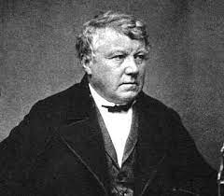
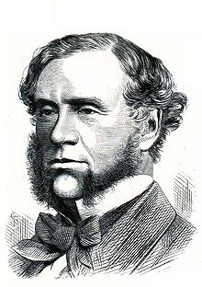
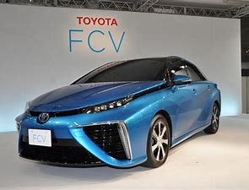
Hydrogen Fuel Cells
Hydrogen Fuel cell was first discovered by German Scientist Christian Friedrich Schoenlein in 1838.
Hydrogen Fuel cell was first demonstrated by Welsh Scientist William Robert Grove in 1839.
Hydrogen Energy
Hydrogen is the simplest and the most plentiful element in the universe.
It’s always combined with other elements.
Hydrogen is high in energy, yet an engine that burns pure hydrogen produces almost no pollution.
NASA has used liquid hydrogen since the1970s to propel the space shuttle and other rockets into orbit.
Christian Schoenbein
William Grove
Siddhesh Khairnar, Department of Engineering and Applied Sciences, VIIT, Pune-48

Slide 7
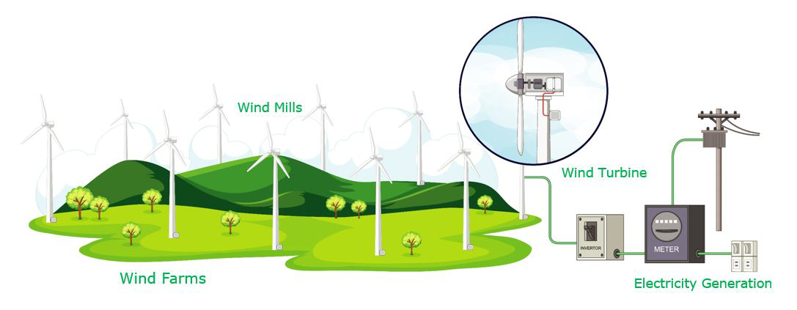
Wind Energy
Wind energy is the process of harnessing wind power to generate electricity. The wind’s kinetic energy is transformed into electrical energy. Because of the earth’s curvature, various parts of the atmosphere are heated to varying degrees when solar radiation enters the atmosphere. The equator receives the most heat, while the poles receive the least.
Winds are created as air moves from warmer to colder locations, and it is these airflows that are captured in windmills and wind turbines to generate electricity. Wind power is not a new discovery; it has been utilized for millennia in the form of conventional windmills – for grinding maize, pumping water, and sailing ships. With improved technology, wind power can now be used to create energy on a bigger scale.
Siddhesh Khairnar, Department of Engineering and Applied Sciences, VIIT, Pune-48

Slide 8
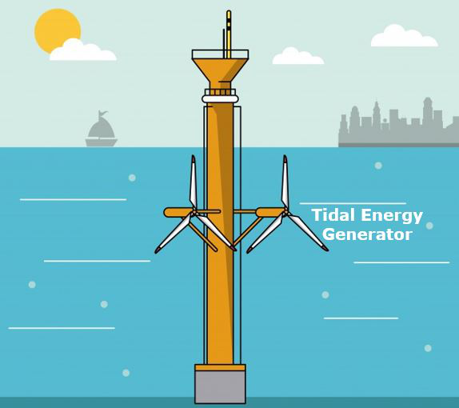
Tidal Energy
Tides is the periodic movement of the ocean waters due to the gravitational force of the moon and the sun. Tides are of two types – high tides i.e the rise of water and low tides i.e. the fall in the level of water. Since it is caused due to the sun and the moon’s gravitational effect, tidal energy is called renewable energy.
The tidal energy from tides are obtained and used to generate electricity using a machine called Tidal Energy Generator. Tidal barrages or dams are built over a limited sea entrance. When the sea level rises, water pours into the dam. This causes the turbine blades, which are connected at the dam’s entrance, to shift. As a consequence, power is generated.
Siddhesh Khairnar, Department of Engineering and Applied Sciences, VIIT, Pune-48

Slide 9
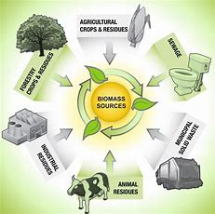
Biomass Energy
The waste and the dead remains of living animals , plants is called bio-mass. They contain carbon compounds. The chemical energy stored in them is called bio-mass energy. This form of energy being used by humans from the very early age. Humans burn wood and cattle dung for cooking for a very long time and is continuing till this date. But this method is not very beneficial as it releases harmful gases into the atmosphere.
A much more advanced and efficient use of biomass is the production of bio-gas from biomass. The bio-gas is produced by the decomposition of biomass in the absence of oxygen. Bio-gas contains nearly 60% methane and rest is carbon dioxide , hydrogen and hydrogen sulfide.
Bio-gas is produced in a large dome shaped plant also called bio-gas plant. In India, however, these plants are called Gobar Gas plant because the main item form which the bio-gas is produced here is cow dung( also called gobar in native language).
Siddhesh Khairnar, Department of Engineering and Applied Sciences, VIIT, Pune-48

Slide 10
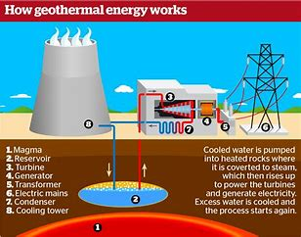
Geo-thermal Energy
Geo-thermal energy is the heat energy possessed by the rocks inside the earth. The places where the rocks inside the hot is very hot are called hotspot.
Now, the heat of these rocks heats up the underground water and turns it into steam. This steam is extracted by drilling hole into the ground and connecting pipeline to rotate the turbine with the help of the steam and produce electricity for use.
In India, only one place is Madhya Pradesh has a hotspot . But in US there are a no. of geo-thermal power plants. The Pacific ring of fire is also a suitable spot for geo-thermal energy sites.
Student’s Name, Department of Engineering and Applied Sciences, VIIT, Pune-48

Slide 11
Advantages & Disadvantages of Non Conventional Energy Source
Advantages:
They are renewable in nature.
They produce little or no pollution as compared to traditional energy sources.
They require little maintenance.
They are a long-term cost-effective choice.
Disadvantages:
The initial setup cost is greater.
Energy cannot be taken 24/7, year-round, because certain days will be windier than others, and the sun will shine. stronger on other days.
Energy must be stored. Geographical locations might be difficult to navigate.
Student’s Name, Department of Engineering and Applied Sciences, VIIT, Pune-48

Slide 12
Conclusion
Student’s Name, Department of Engineering and Applied Sciences, VIIT, Pune-48

Slide 13
References
Future Perspective For Non-Conventional Sources of Energy In India – GeeksforGeeks
advantages of non conventional energy sources - Search (bing.com)
Energy - Law of Conservation of Energy, Energy Conversion, Different Forms Of Energy, FAQs (byjus.com)
Student’s Name, Department of Engineering and Applied Sciences, VIIT, Pune-48

Slide 14

Mr. Vivek Shripad Nagnath, Department of Engineering and Applied Sciences, VIIT, Pune-48

